Slide 1




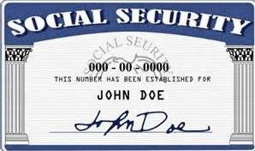
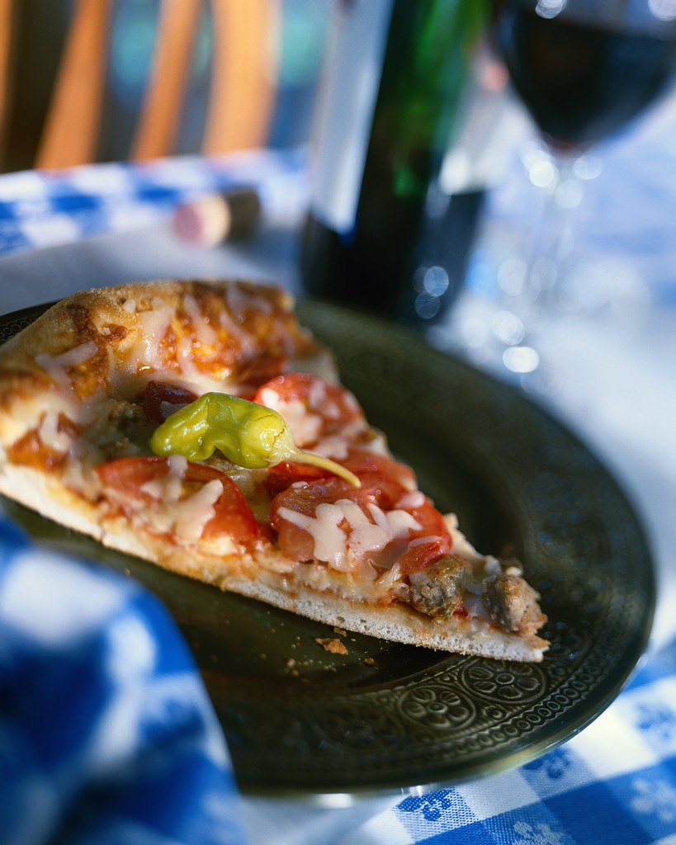
Fundamental Counting Principle – Part 1
Samuel Chukwuemeka B.Eng., A.A.T, M.Ed., M.S
www.samuelchukwuemeka.com
The Joy of a Teacher is the Success of his Students. – Samuel Chukwuemeka

Slide 2
Objectives
Students will
Determine the number of ways two tasks can be done consecutively.
Determine the number of ways multiple tasks can be done successively.

Slide 3
Fundamental Counting Principle
The Fundamental Counting Principle is also referred to as:
The Fundamental Principle of Counting. OR
The Multiplication Principle. OR
The Counting Principle. OR
The Principle of Counting.

Slide 4

I Sing and Dance ☺
I sing tenor.
I sing bass.
I dance Ibo traditional dance.
I dance reggae dance.
I dance disco dance.
How many ways can I sing and dance?

Slide 5
The Fundamental Counting Principle
States that:
If
A task can be done in A ways and
Another task can be done in B ways;
Then
The total number of ways of doing both tasks consecutively is A * B ways.

Slide 6
What if we have to do multiple tasks?
That leads us to the Generalized Multiplication Principle.
This states that:
The total number of ways of doing multiple tasks in succession is the product of the number of ways of doing each task individually.

Slide 7
Example 1
Mr. C has two shirts – a black shirt and a white shirt. He has three pants – a black pant, a red pant, and a green pant. In how many ways can he dress up for work using any combination of shirt and pant?

Slide 8

Example 2
Zinne Diners offers twelve main courses, five desserts and seven sides. How many ways can a person order a three-course meal?

Slide 9
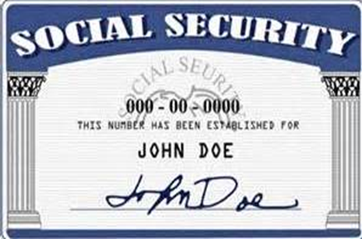
Example 3
The U.S social security number contains nine digits. How many different social security numbers are possible if
(a.) repetition of digits is allowed?
(b.) repetition of digits is not allowed?
(c.) the first number cannot begin with 0?

Slide 10
Solution to Example 3

Slide 11

Example 4
The local seven-digit telephone numbers in Jacksonville, Alabama have 256 as the first three digits. How many different telephone numbers are possible in Jacksonville, Alabama?

Slide 12
Example 5
You a taking a multiple choice question test that has 5 questions and 4 answer choices. You must attempt all questions and select one choice for each question. How many ways can you answer the questions?

Slide 13
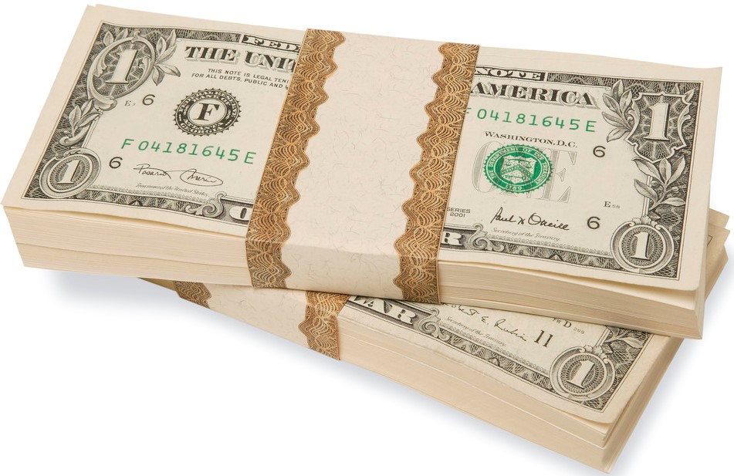
Example 6
Sometimes, the value of a stock may go up, go down, or remain constant. Assume you own ten stocks, how many possibilities do you have?

Slide 14
Example 7
In the original plan for area codes in 1945, the first digit could be any number from 2 through 9; the second digit was either 0 or 1; and the third digit could be any number except 0. How many different area codes are possible with this plan?

Slide 15
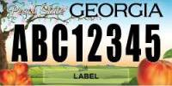
Example 8
The new license plate of the State of Georgia has three letters followed by five numbers. How many license plates of this kind are possible if:
(a.) repetition of letters and numbers is allowed?
(b.) repetition of letters and numbers is not allowed?
(c.) repetition of letters is allowed but the repetition of numbers is not allowed?
(d.) repetition of letters is not allowed but the repetition of numbers is allowed?

Slide 16
Solution toExample 8

Slide 17
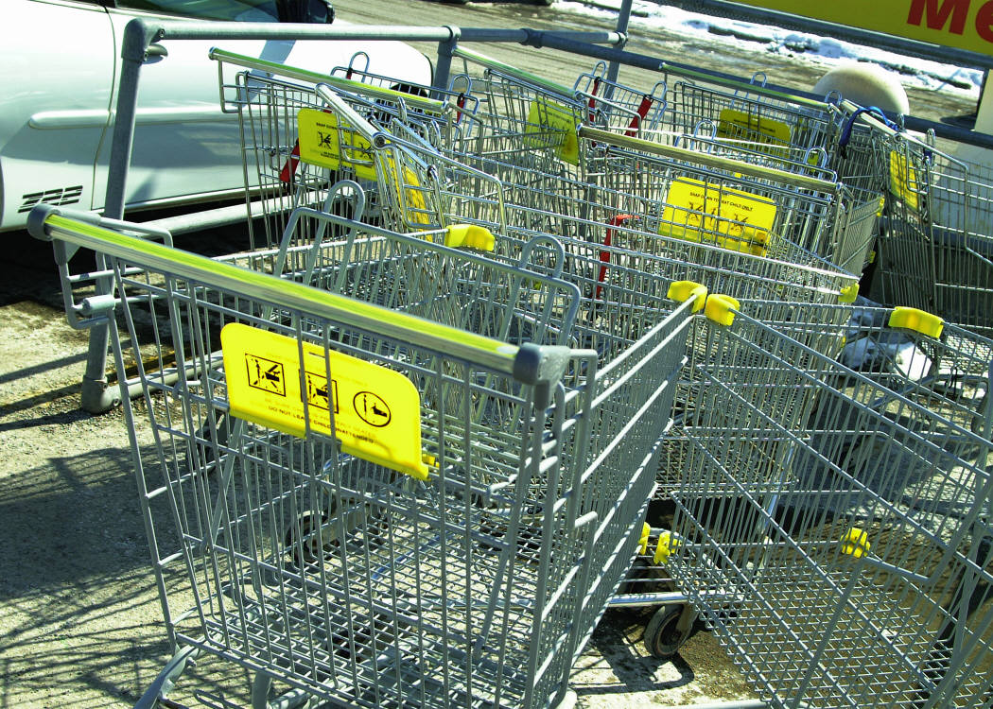
Example 9
C-Mart Stores has a new store in Two Egg, Florida. One of their employees has to paint the parking spaces with a letter of the alphabet and a single digit from 1 to 9. The first parking space is A1 and the last parking space is Z9. How many parking spaces can be painted with distinct labels?

Slide 18
Example 10
How many different five-letter radio station call letters can be formed if the first letter must be S or C?

Slide 19
References
Blitzer, R. (2015). Thinking Mathematically Plus New Mymathlab With Pearson Etext Access Card. (6th ed.). Pearson College Div.
Images taken from http://georgia.gov/blog/2012-05-16/new-license-plates-available; http://office.microsoft.com/en-us/images/business-CM079001906.aspx; http://en.wikipedia.org/wiki/

